Slide 1




진우가 만듬!
AI
Comparison and result
01

Slide 2
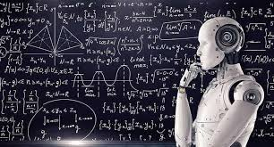
진우가 만듬!
Index
01
CHATGPT-4O
02
CHATGPT-4O (mini)
CHATGPT model to analyze stock news!
Reason: I am into Quantitative Finance
CHATGPT mini model to analyze stock news!
03
GEMINI
04
Conclusion
Gemini to analyze stock news!
Which is the best?
01

Slide 3
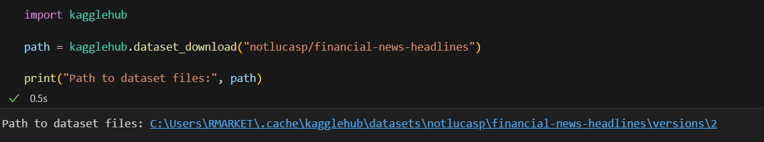
진우가 만듬!
Data that I input
DATA
What I selected:
'The S&P 500 \'could get ugly\' in the near future, Jim Cramer warns <Description:>The S&P 500 could be riding into a "make-or-break moment" in the short term, the "Mad Money" host said.'
Reason: The news talks bad about S&P.
02

Slide 4
진우가 만듬!
Key Point
The S&P 500 is a stock market index developed by the American credit rating agency Standard & Poor's.
Along with the Dow Jones Industrial Average and the Nasdaq Composite, it is considered one of the major stock indices in the U.S. Among these, the S&P 500 is seen as the most representative, as it includes around 500 large companies that account for more than 80% of the market capitalization of publicly traded U.S. companies. It is often regarded as a benchmark index for the market.
In other words, it can be considered a relatively safe asset (though don't blindly invest just because of that 😳).
(While it’s generally considered a safe stock, the selected news tends to focus on the negative side, which can sometimes be misleading 😊).
I was curious to see if the chatbot can see that S&P is safe asset regardless of what media says (spoiler: it can’t)
01

Slide 5
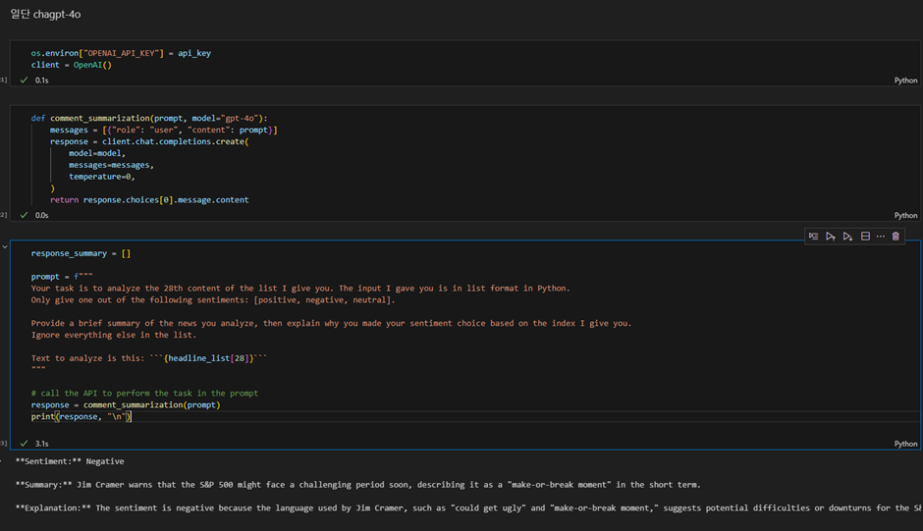
진우가 만듬!
CHATGPT-4O
utilization
Prints out result well.
Result: negative.
Reason: title (ugly), content (make-or-break)
03

Slide 6
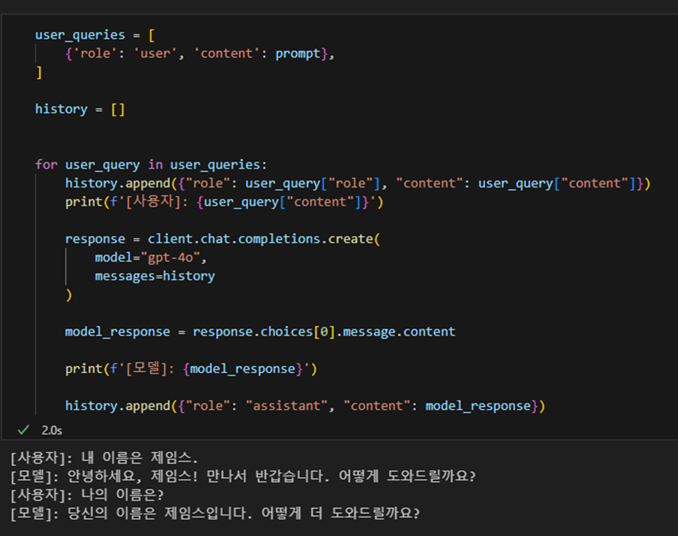
진우가 만듬!
CHATGPT-4O
utilization
It remembers the conversation!
04

Slide 7
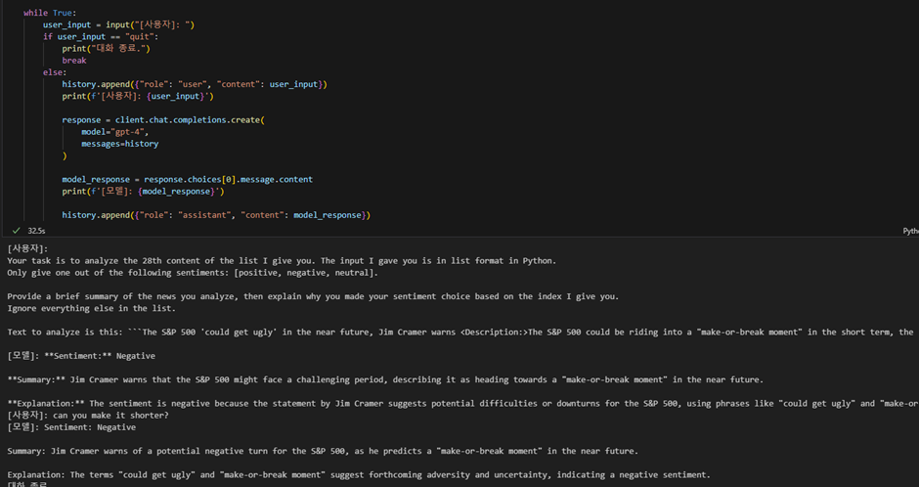
진우가 만듬!
CHATGPT-4O
사용
Asked for summary🙏
Comparison is based on this result!
05

Slide 8
진우가 만듬!
CHATGPT-4O-mini
utilization
06

Slide 9
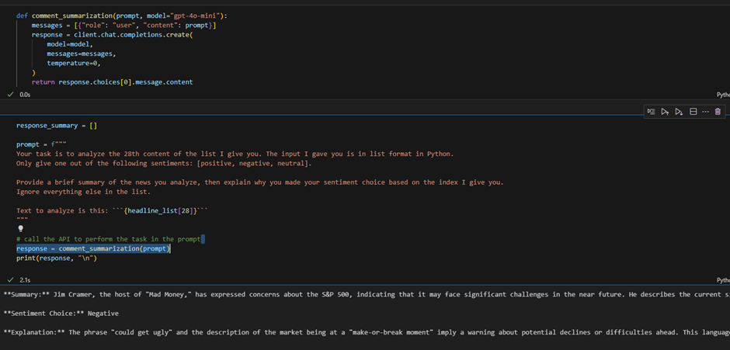
진우가 만듬!
CHATGPT-4O-mini
utilization
Prints out result well.
Result: negative.
Reason: title (ugly), content (make-or-break)
07

Slide 10
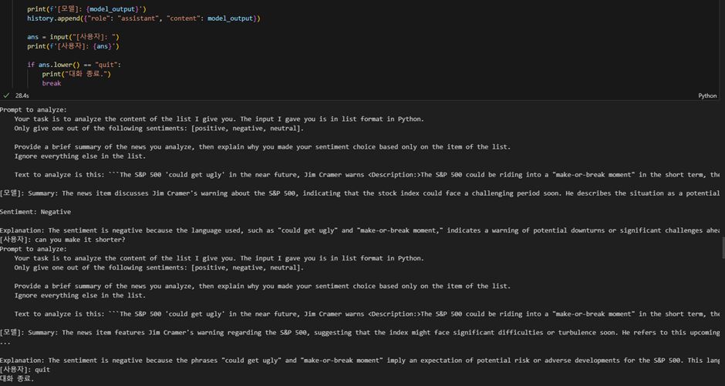
진우가 만듬!
CHATGPT-4O-mini
utilization
Asked for summary 🙏
08

Slide 11


진우가 만듬!
GEMINI
09

Slide 12
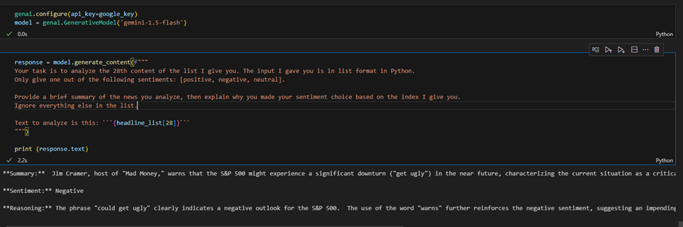
진우가 만듬!
GEMINI
utilization
Prints out result well.
Result: negative.
Reason: title (ugly)
10

Slide 13
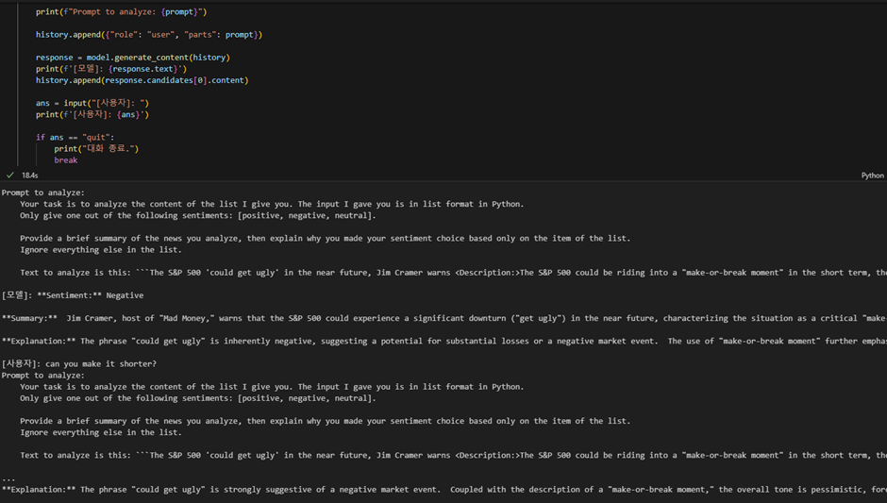
진우가 만듬!
GEMINI
Asked for summary 🙏
problem: It summarized everything (way too much -> got rid of important content) 😠
11

Slide 14


진우가 만듬!
So…
What is the result?
In summary
GPT4O > GPT-4O-mini > Gemini
12

Slide 15
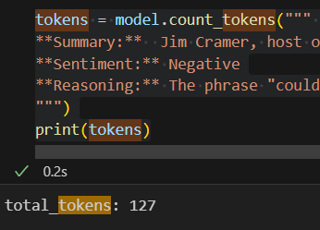
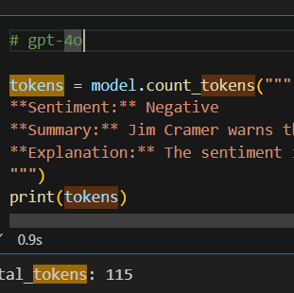
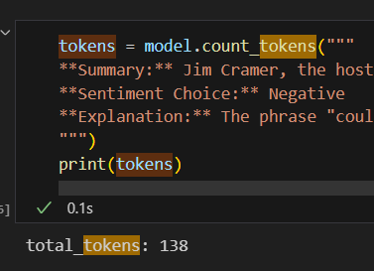
진우가 만듬!
# of Token
(no summary)
GPT4O
GPT4O-mini
GEMINI
13

Slide 16
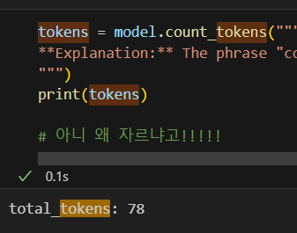
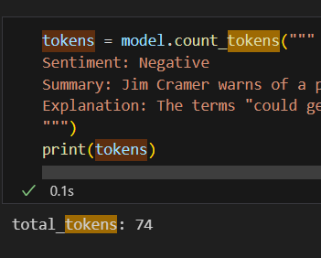
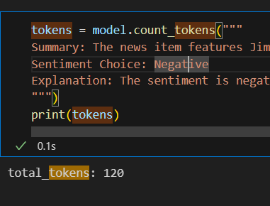
진우가 만듬!
GEMINI
# of Token
(with summary)
GPT4O
GPT4O-mini
quantity over quality:
1) 4o -> has both
2) mini -> only has quality
3) gemini -> only has quantity
14

Slide 17
진우가 만듬!
Conclusion and Key Points
When evaluating news, it is important to see if the news is credible (chatbot really can’t do that, they usually just take info as of 2024)
Determining fake or real news can be done using deep learning! So, combination of deep leaning and ai would be amazing.
For a real-world stock project, it will be required to determine credibility of news data and what people think on the news (crawl social media data)!
01

Slide 18
진우가 만듬!
THANK
YOU
15

